Slide 1
PRESENTATION TITLE
HOME LOANS
1/07/2023

Slide 2
TEXT LAYOUT 1
Agenda
Data Science Lifecycle​
Project Overview​
Data
Analysis
Modeling
Model Evaluation
Recommendations

Slide 3
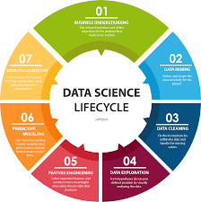
TEXT LAYOUT 1

Slide 4
Business Problem:The current process involves loan officers having to manually process home loan applications. This process takes 2 to 3 days to process upon which the applicant will receive communication on whether or not they have been granted the loan for the requested amount.
Business Objective: To reduce the amount of time it takes for a applicants for their loan statuses
Hypothesis: we use machine learning model with the data we have acquired and predict the loan statuses

Slide 5
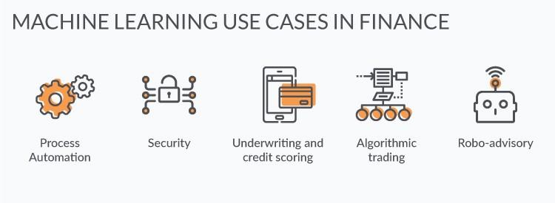
TEXT LAYOUT 1
Process Overview / Solution

Slide 6
TEXT LAYOUT 1
Data
Number of Records - 614
Number of columns - 13
Loan Status - Y(422[69%]) ; N(192[31%])

Slide 7
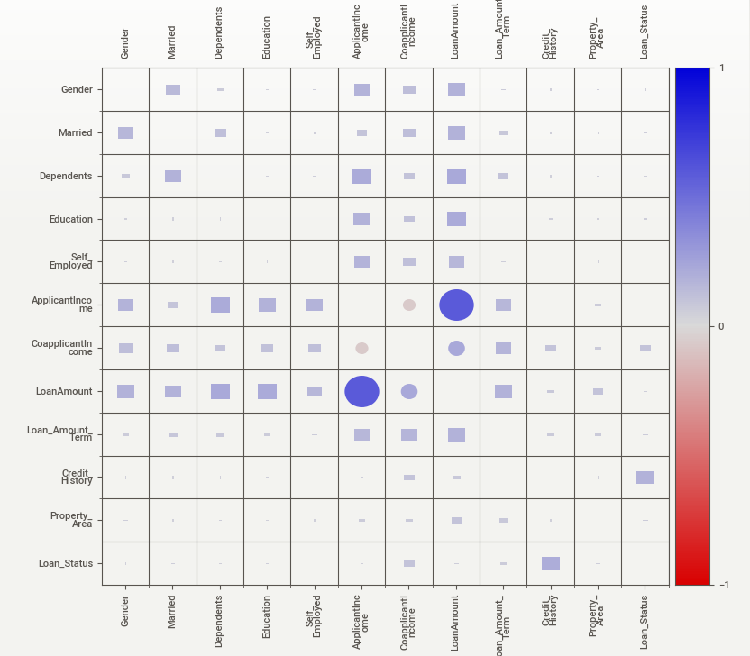
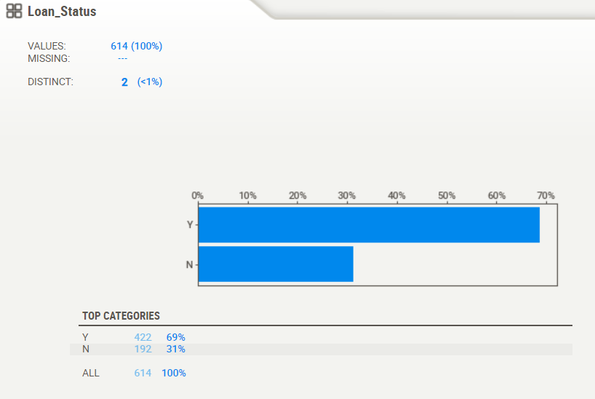
TEXT LAYOUT 1
Analysis

Slide 8
TEXT LAYOUT 1
Modeling
MAchine Learning model trained and AutoML used.
AutoMl did not required any preprocessing whereas the Bespoke model needed.
But the results are similar.

Slide 9
TEXT LAYOUT 1
Model Evaluation
Accuracy for AutoMl — 79%
Accuracy for Bespoke — 77%

Slide 10
TEXT LAYOUT 1
Recommendations
AutoML is a Basic model.
Bespoke ML is best when compared to AutoML

